Slide 1

{ Shopping } E-COMMERCE SPRING-BOOT
wEB Application architecture
By gayan samuditha

Slide 2

ARCHITECTURE DESIGN

Slide 3
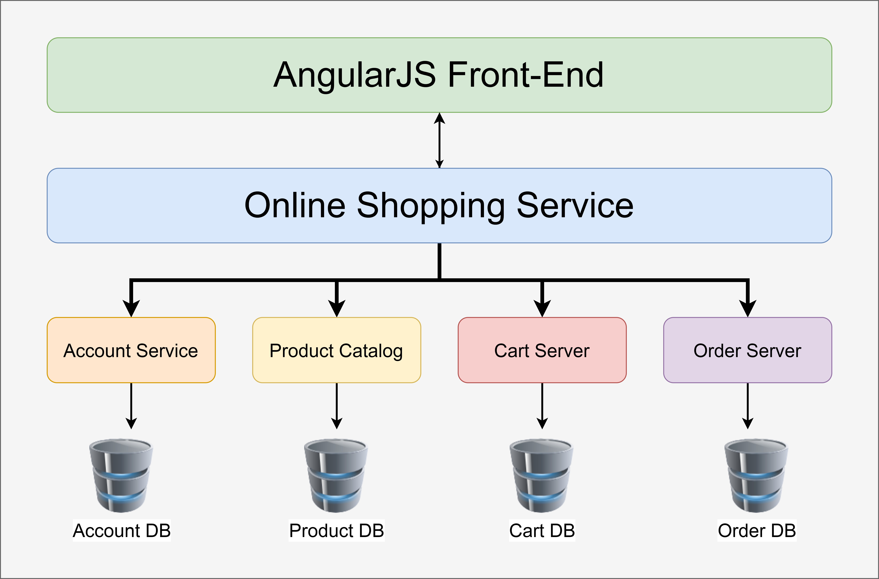
Block diagram

Slide 4
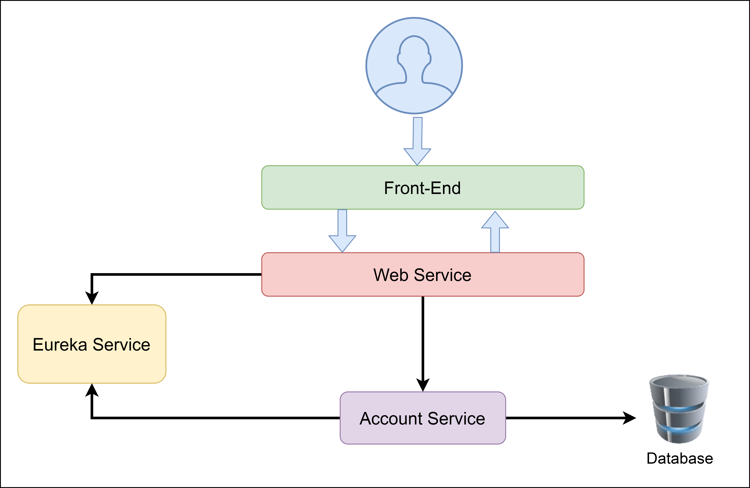
Client-Side Load Balancing

